Slide 1

Deep learning with Neural Networks
Logistic Regression, Stochastic Optimization
& Regularization
Pablo Martínez Olmos, pamartin@ing.uc3m.es

Slide 2



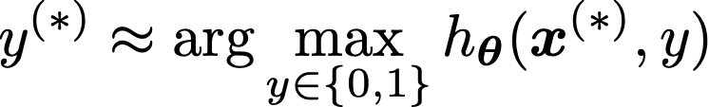
A binary classification problem
Training database:
Goal: to propose an hypothesis function to estimate the most likely class of a new data point
Parameters to be optimized using
the training set

Slide 3
Logistic Regression: the model

Slide 4
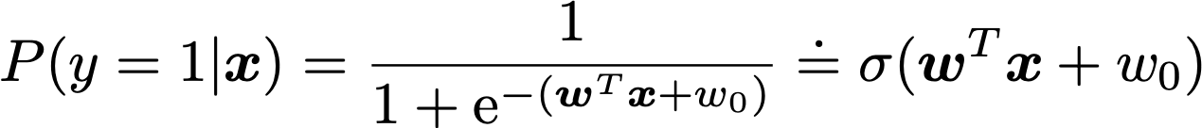

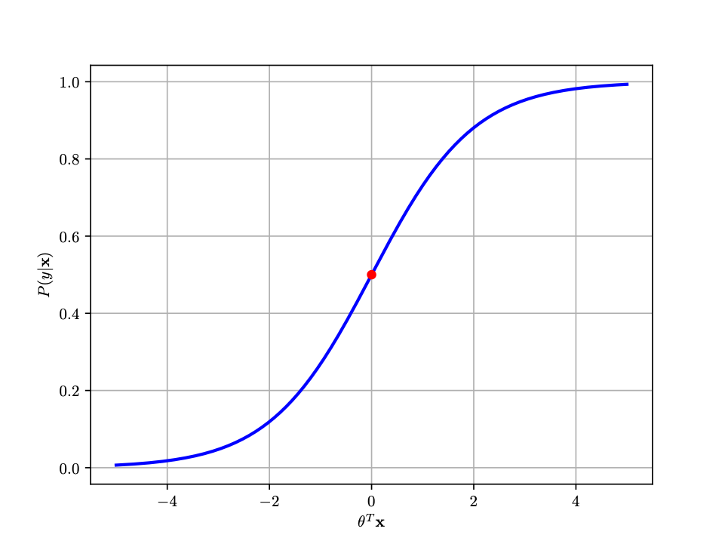

Binary Logistic Regression
Discriminative classifier:
Generalized linear model
Decision boundary:
Hyperplane! Linear classifier

Slide 5
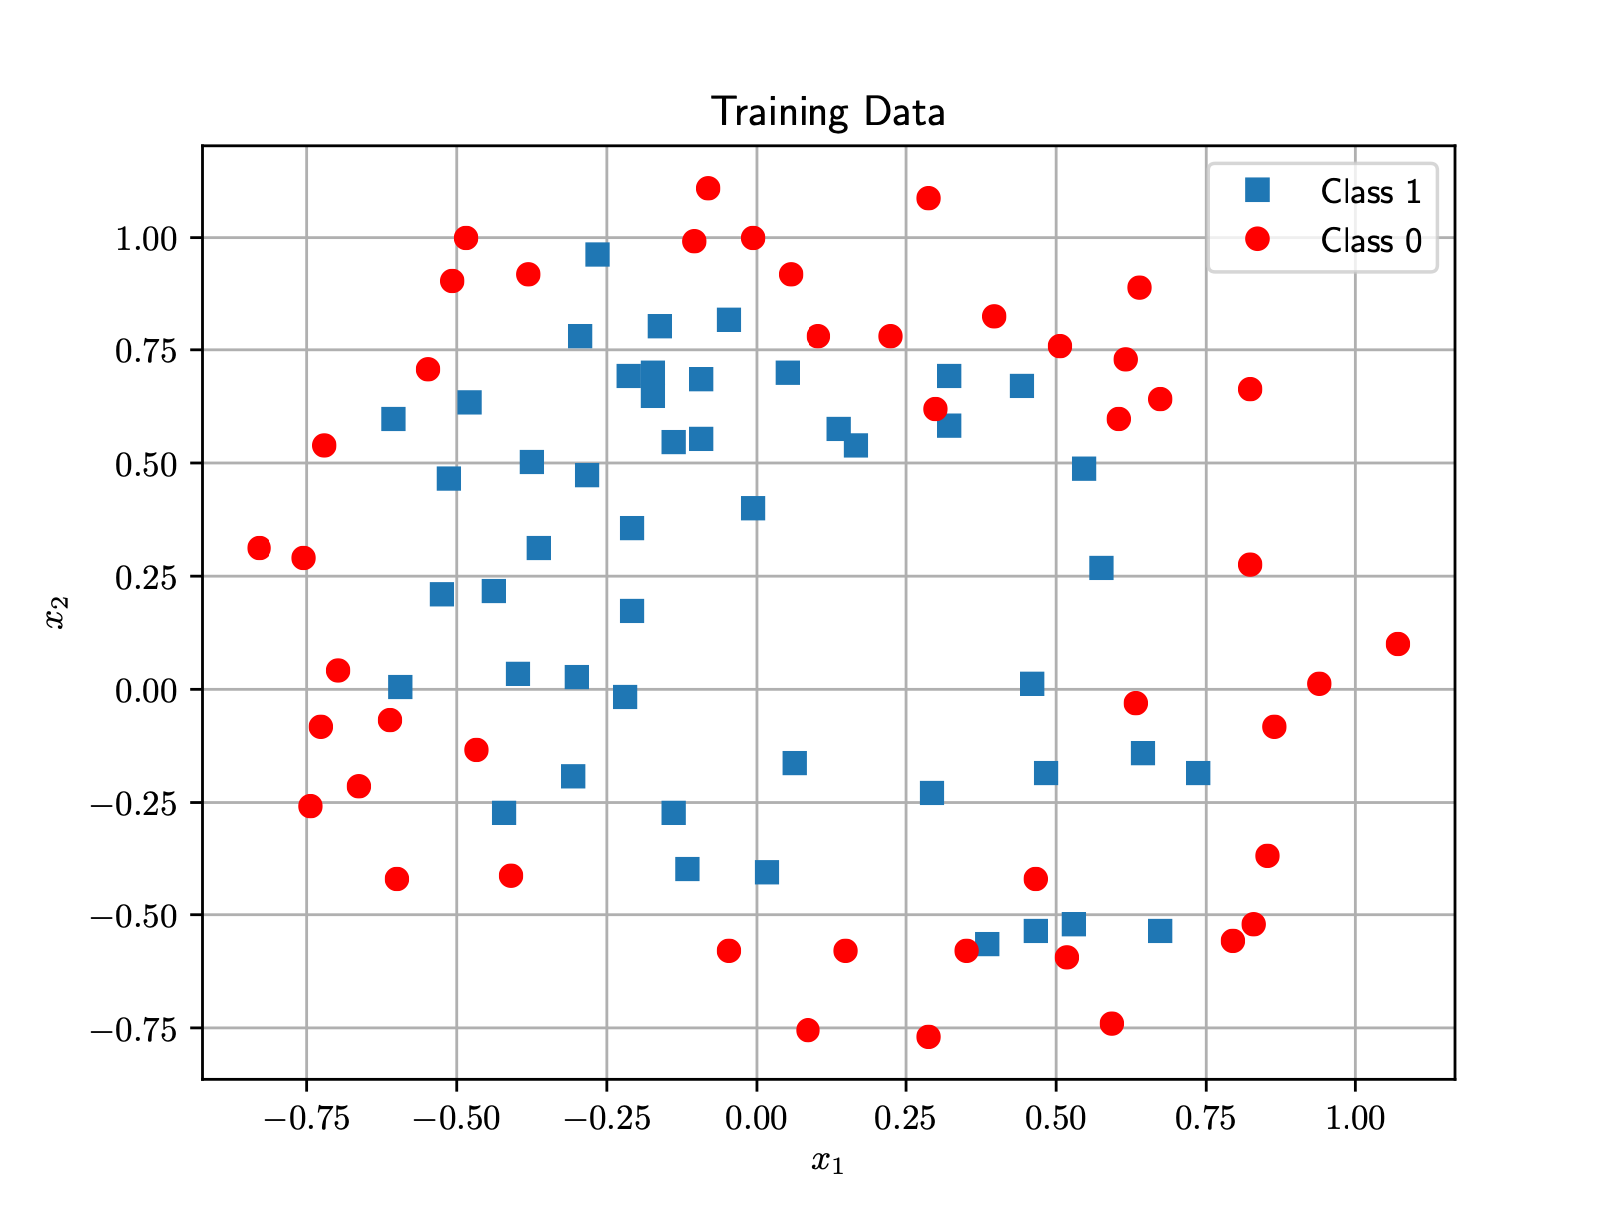
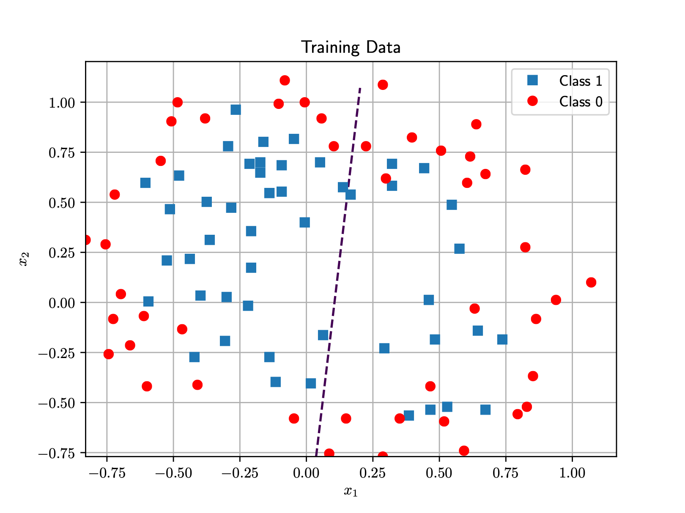
Binary Logistic Regression
LR decision boundary with linear features

Slide 6
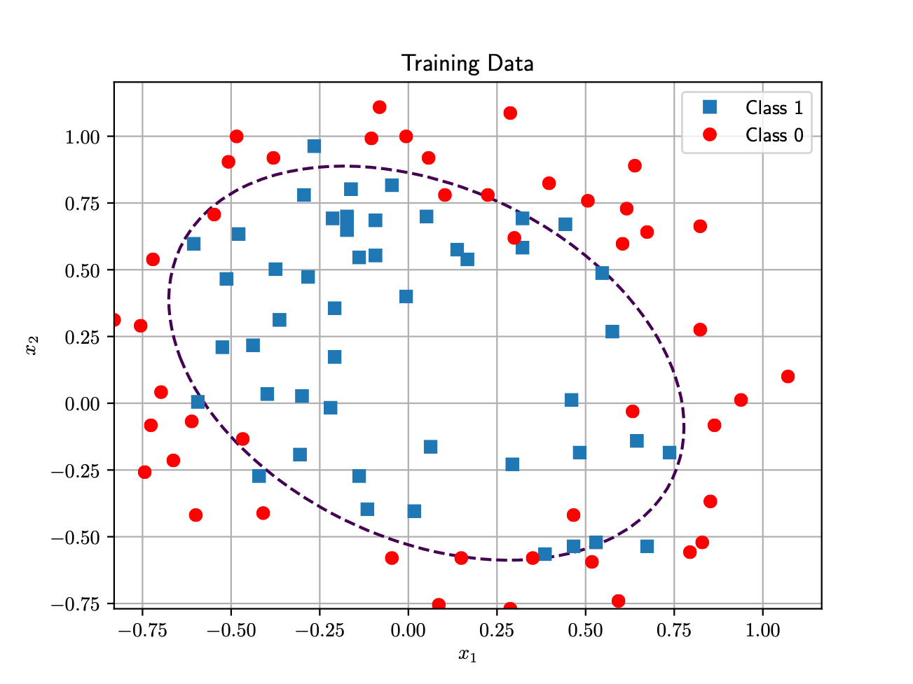
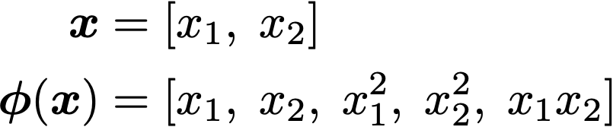
Binary Logistic Regression. Adding new features
The problem is easy to visualize
An ellipsoid clearly fits better as decision boundary than a straight line
Expand input space with extra degrees of freedom
Quadratic features

Slide 7
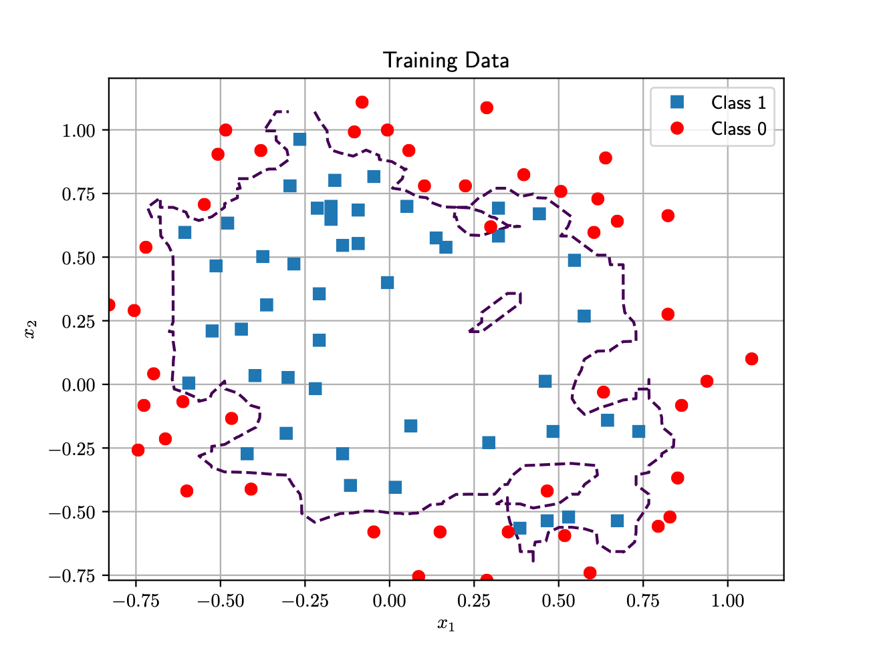
Binary Logistic Regression. Adding more and more features
By adding new features we allow the model to fit (even overfit) to the training data
We need a validation set to evaluate the model’s exposure to overfitting
Provided you find the right set of features!
VERY hard problem in general. Requires domain-specific knowledge.
What is the equation of such a weird boundary?

Slide 8
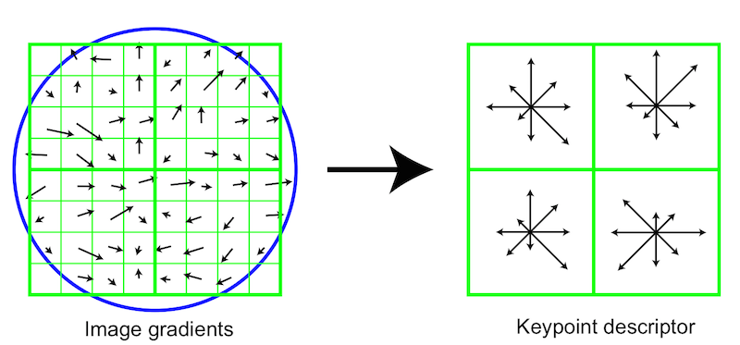
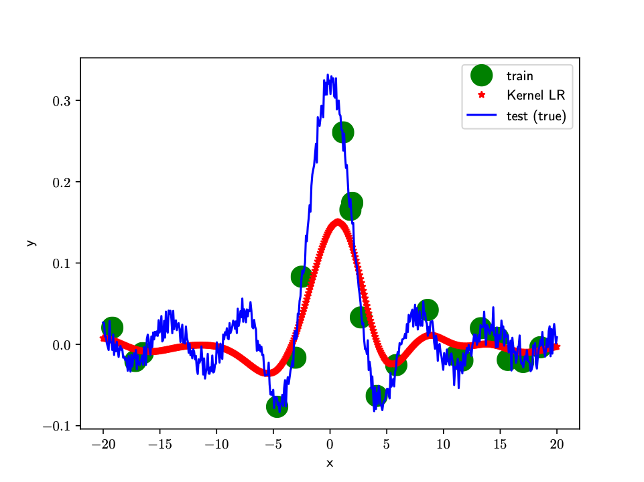
Ways to go …
Manual feature design: complex in high-dimensional settings, domain-specific knowledge
E.g. SIFT features in an image (Image taken from this excellent blog)
Kernel methods: you do not think on feature space, but on the data space (~ interpolate with your neighbours). Computationally very complex for large databases.
Example of kernel regression with Gaussian kernel

Slide 9
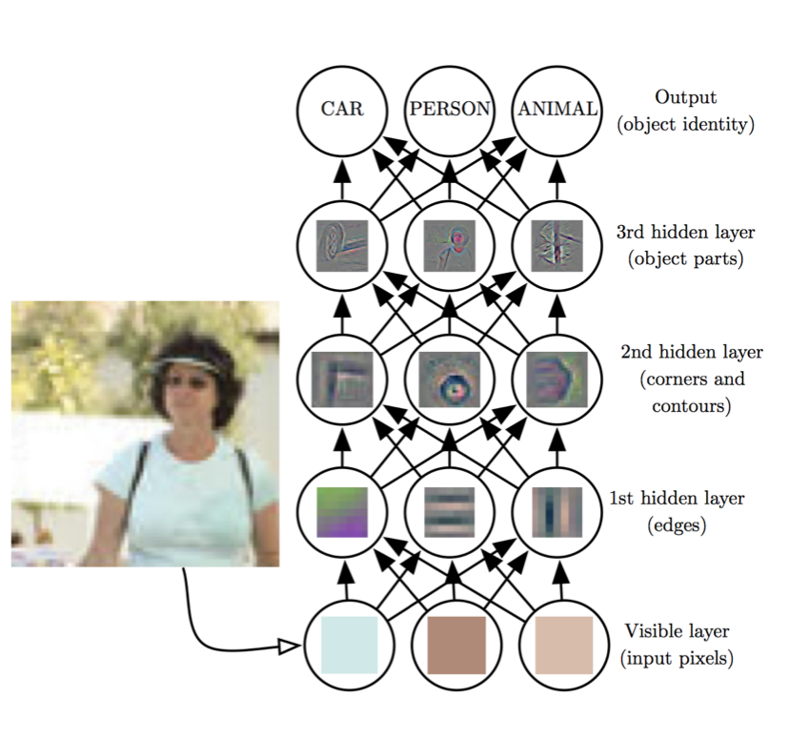
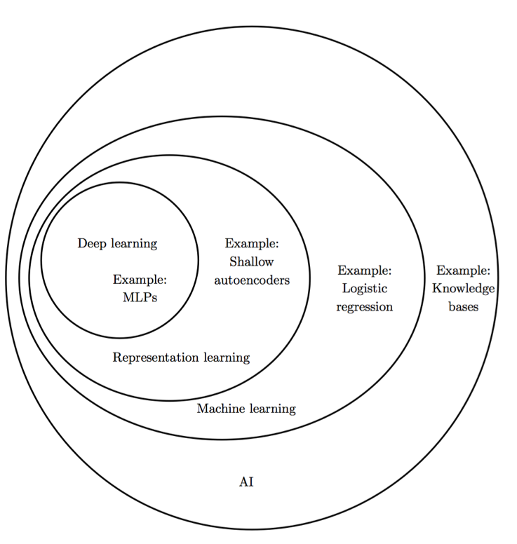
Ways to go …
Representation Learning: use raw-data and a highly flexible family of transformation functions.
Neural networks belong to this class of methods!!
Source: Deep Learning, Good Fellow et al. 2017

Slide 10
Logistic Regression: training

Slide 11
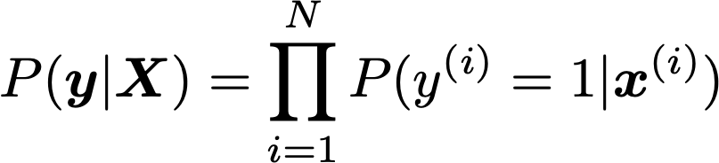
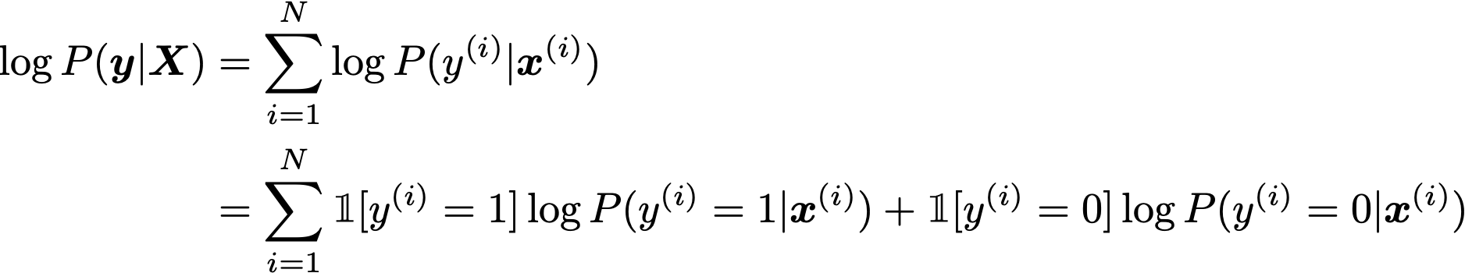
Binary Logistic Regression. Maximum likelihood training
Hypothesis function:
Training database:
(Log)-Likelihood function:

Slide 12

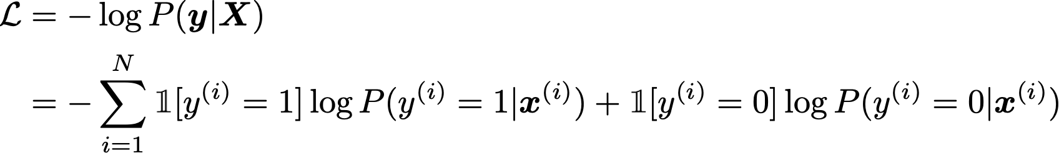

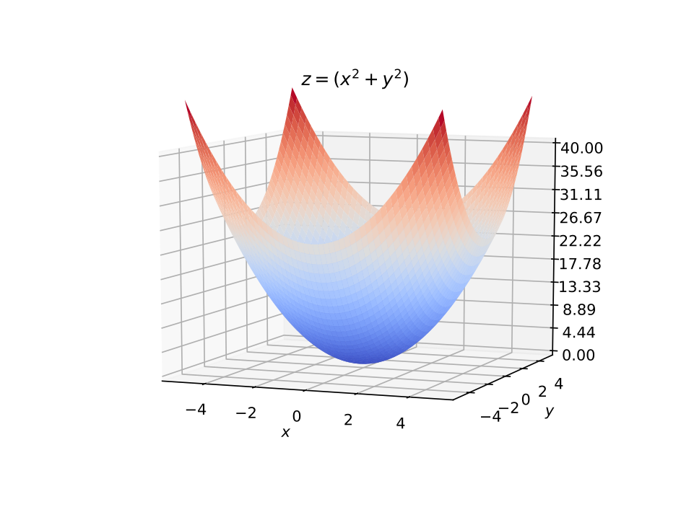

Binary Logistic Regression. Binary Cross Entropy Function
Binary Cross Entropy Function
is convex!!
Logistic Regression Training

Slide 13


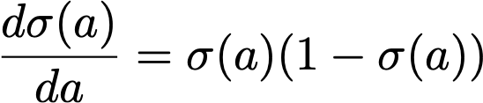

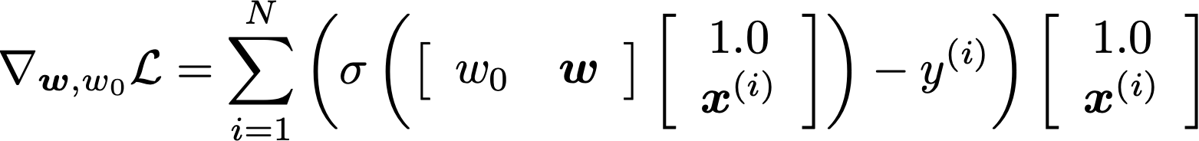
Logistic Regression Training
Logistic Regression Training
No closed-form solution!
By using that it can be shown that
Prediction error
(real scalar)
Vector
(bias + data point)
Gradient is a weighted-sum of training data points

Slide 14



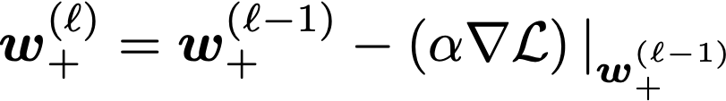
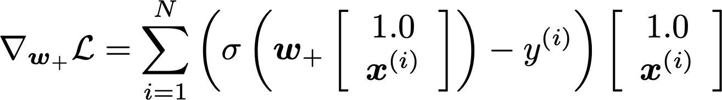
Gradient Descent (GD)
the step size
Choosing the step size manually is a hard problem!

Slide 15





Gradient Descent
If is too large ….

Slide 16
Gradient Descent
If is too small ….

Slide 17
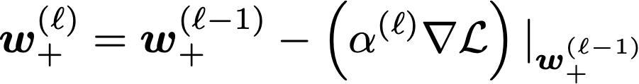
Line Search methods: automatically running the step size
Estimate the largest possible step size that guarantees that the function decreases
Every state-of-the-art Deep Learning library contains implementations of various algorithms to optimize gradient descent
Momentum, Adam, Adagrad, …
Check out in Aula Global two excellent posts on SGD methods for Deep Learning
(Link1, Link2)

Slide 18
Logistic Regression:
Stochastic gradient descent

Slide 19


Stochastic Optimization (Mini-batch Optimization)
Expensive for very large databases!!
Mini-batch optimization
Select at random a mini-batch of data at every SGD iteration

Slide 20
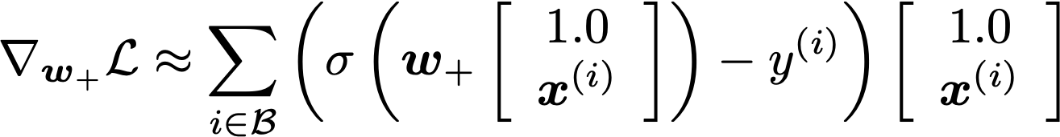
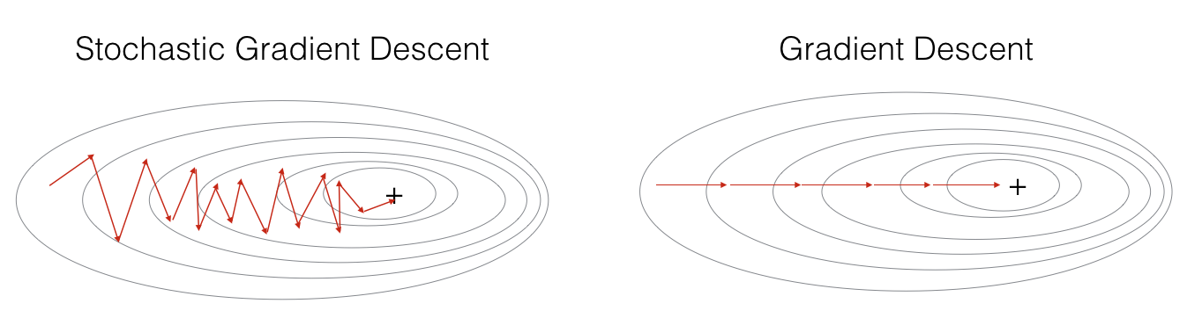
Stochastic Optimization (Mini-batch Optimization)
Source: this post

Slide 21
Logistic Regression: regularizing the weight norm

Slide 22
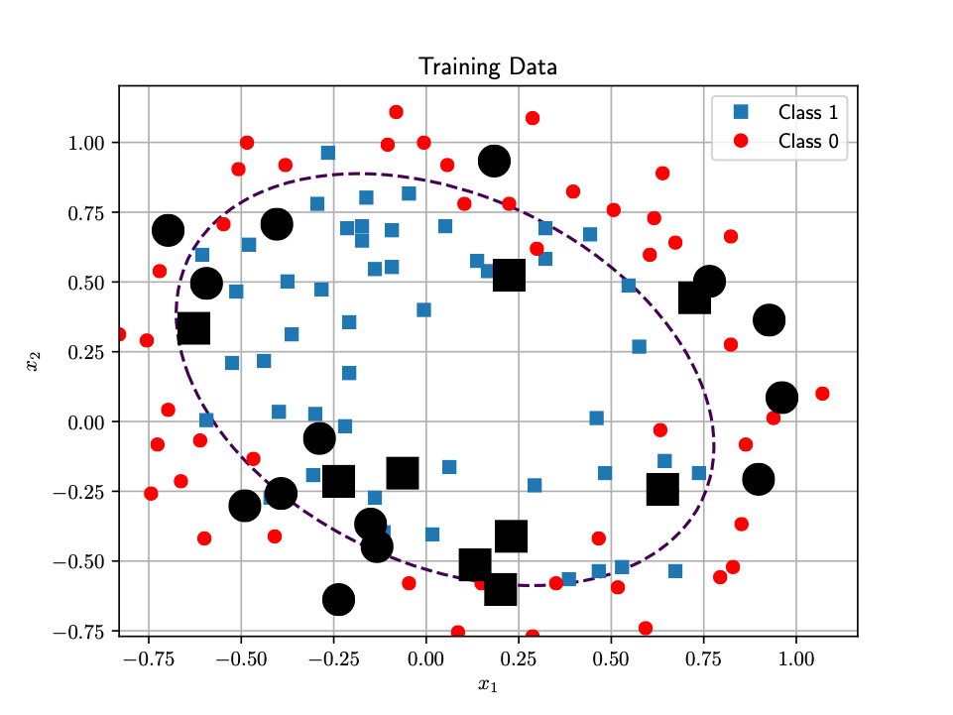
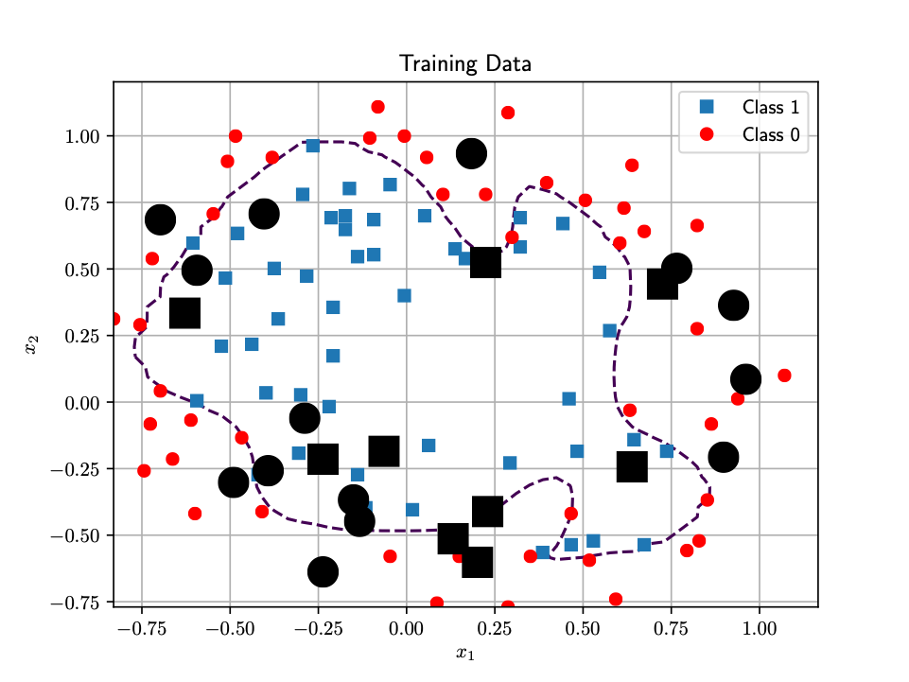

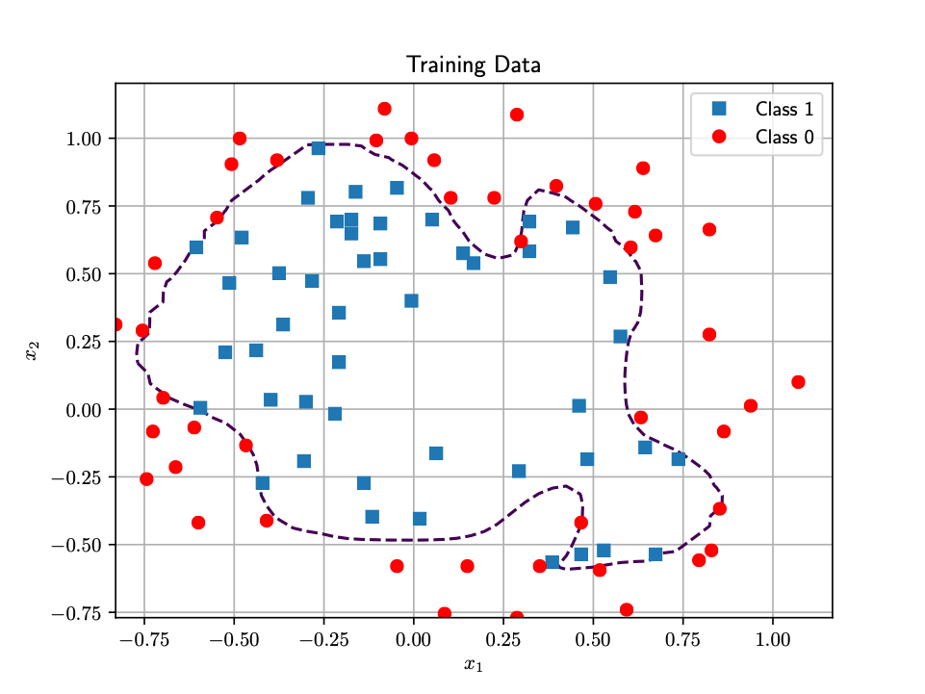
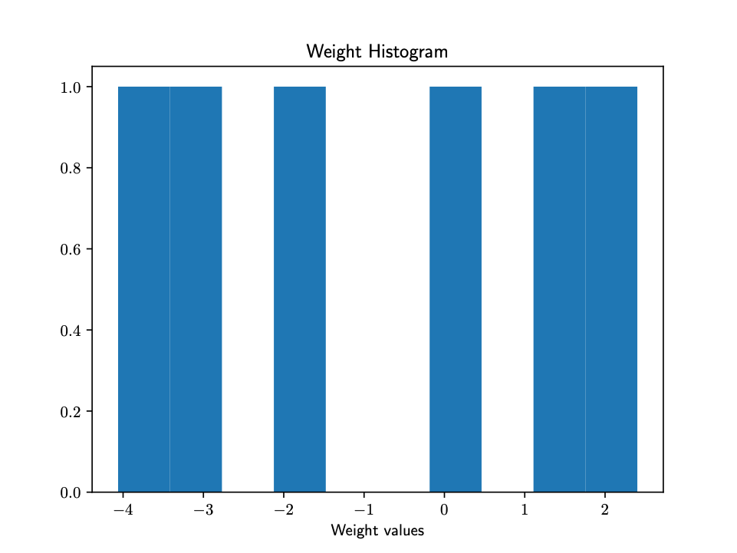
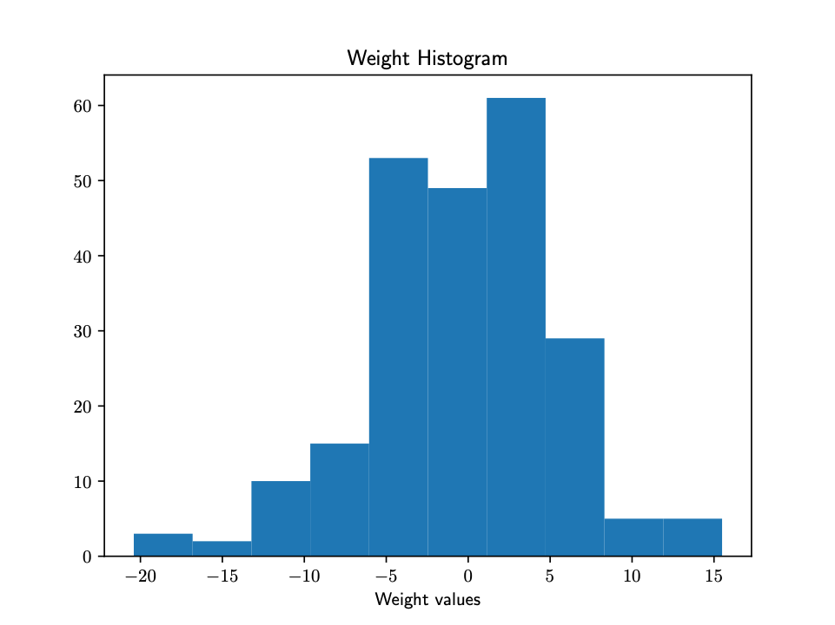
Binary Logistic Regression. Adding new features
OVERFITTING
Test accuracy = 65.2 %
Test accuracy = 60.8 %

Slide 23
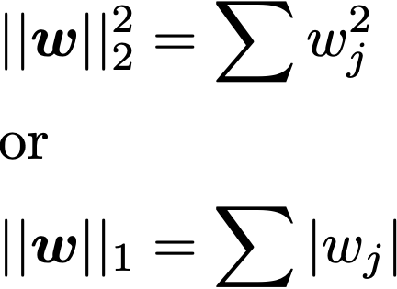
Weight norm regularization
Large weights are associated to overfitting issues
Instead of manually reducing the number of features, it is easier to pelanize solution for which
are very large.
L2 regularization
L1 regularization
Regularized Logistic Regression:
Regularization Parameter
Cross validation!!

Slide 24
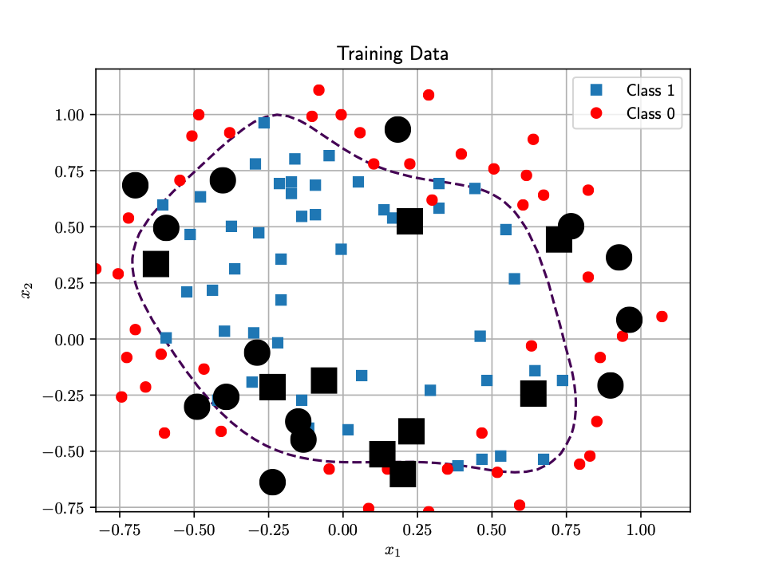
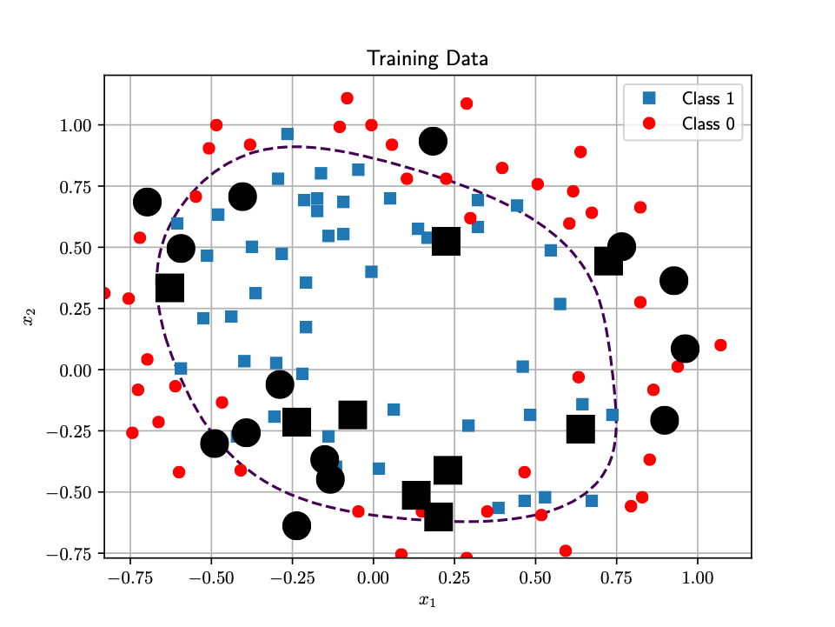
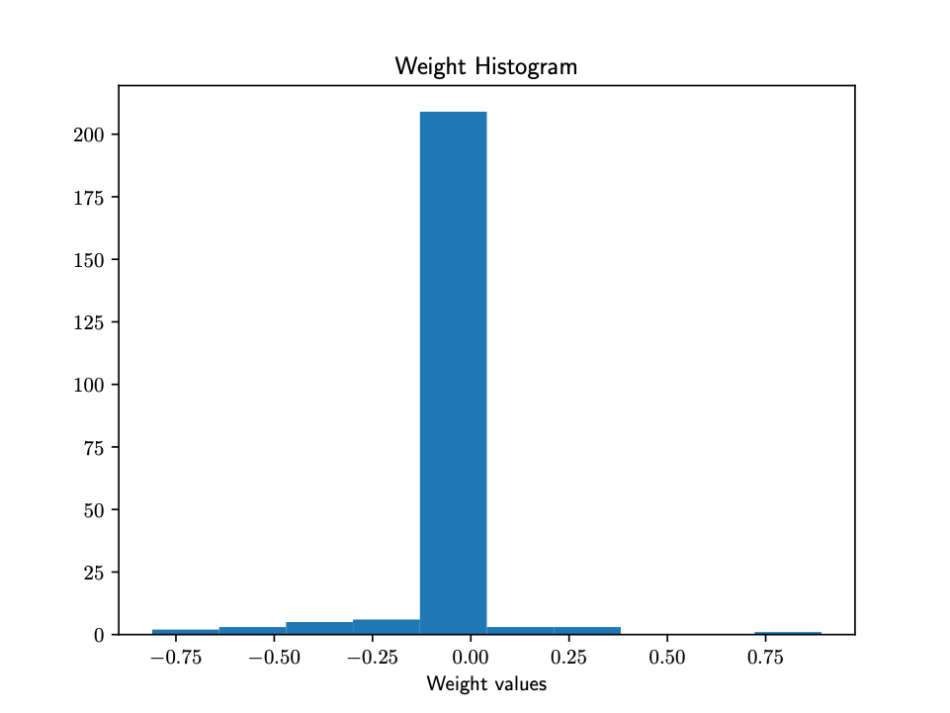
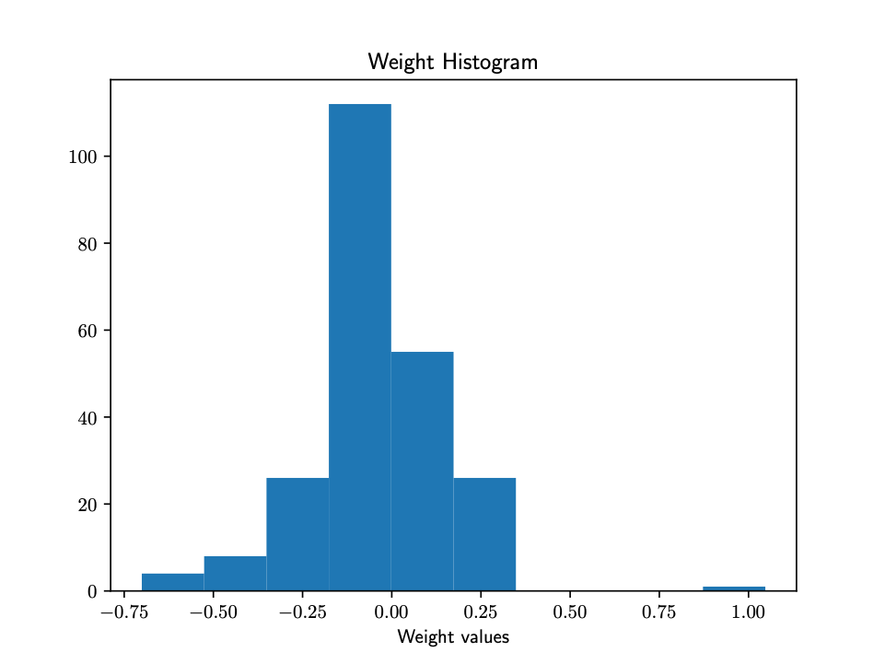


Weight norm regularization
Test accuracy = 60.8 %
Test accuracy = 65.2 %
Test accuracy = 69.5 %

Slide 25
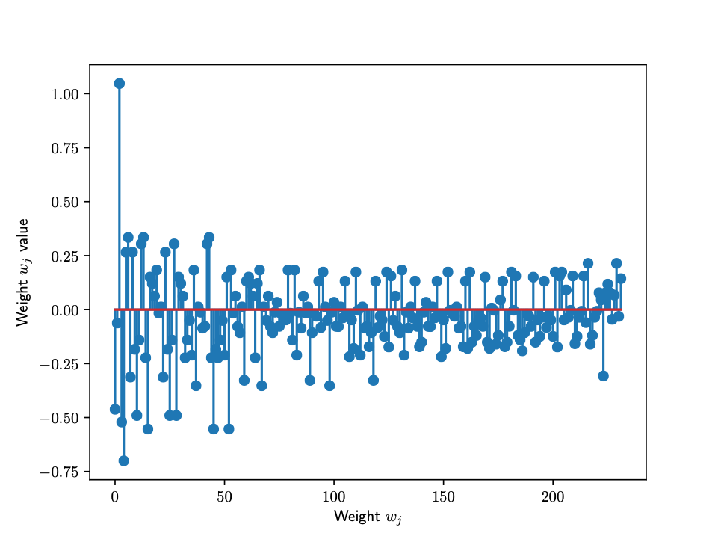
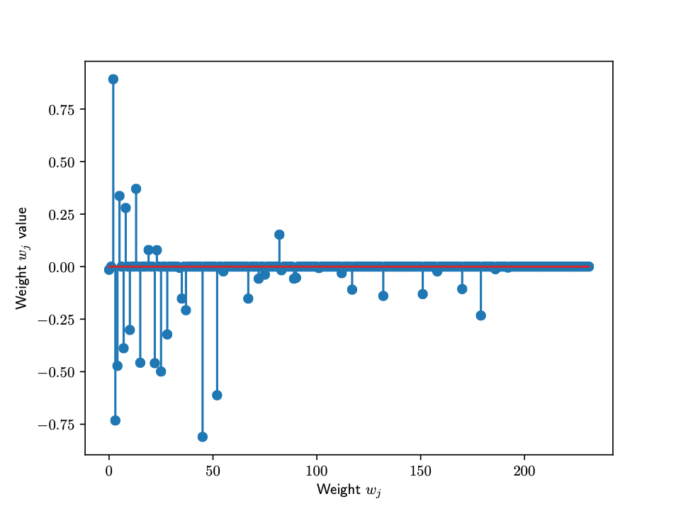
L1 norm regularization induces sparsity
With L1 regularization, many weights go to zero. Good for feature selection!
Numerical optimization with L1-type of regularizers is more challenging
Check out in Aula Global this explanation about sparsity with L1 (by Emily Fox):
Link

Slide 26
Logistic Regression: multiple classes

Slide 27
Binary Logistic Regression
Discriminative classifier:
Generalized linear model
Decision boundary:
Hyperplane! Linear classifier

Slide 28

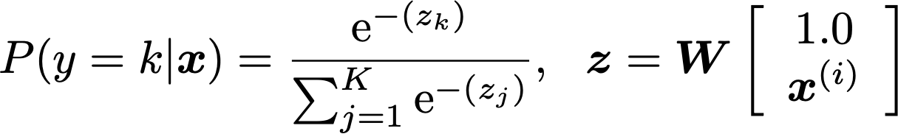


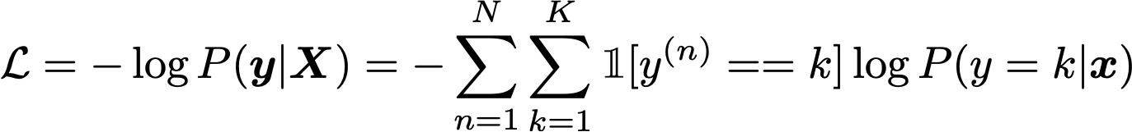
Multiclass Logistic Regression
Training database:
Discriminative classifier based on the Softmax function:
Loss function (Cross entropy):
Similar gradient expression

